Slide 1


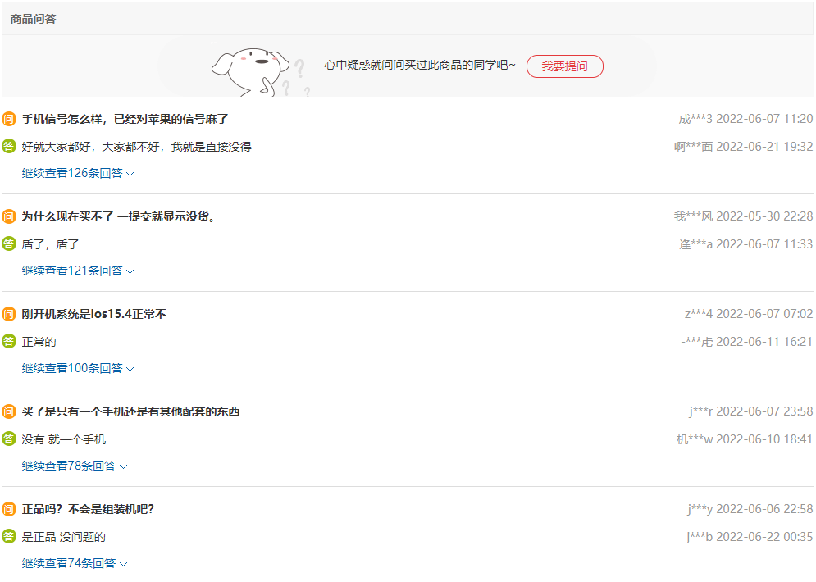
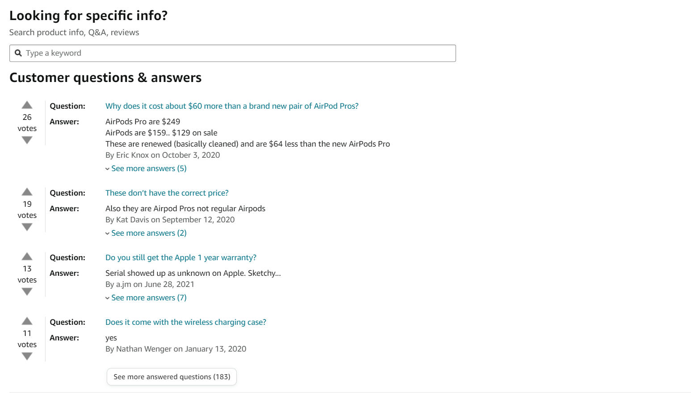
Customer Q&A Feature

Slide 2
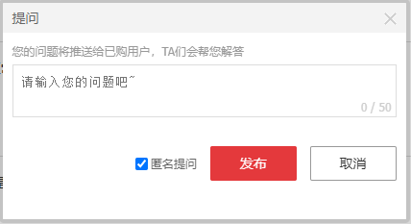
Customer Q&A Feature
This is the Customer Q&A from JD.com

Slide 3
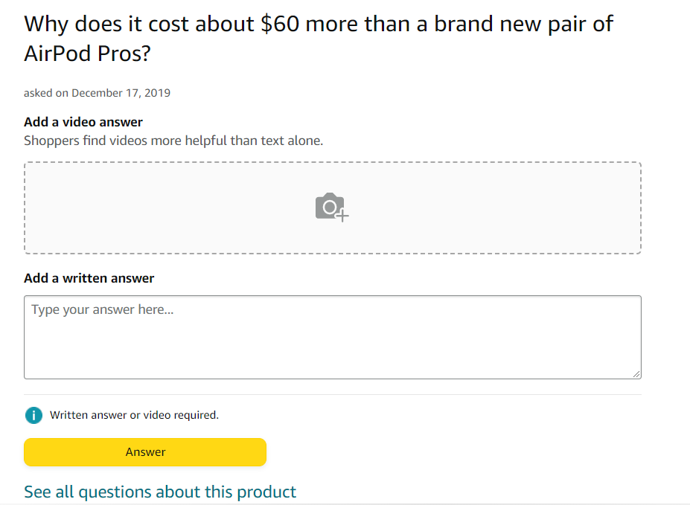
Customer Q&A Feature
This is the Customer Q&A from Amazon

Slide 4



Sidebar Shopping Cart

Slide 5
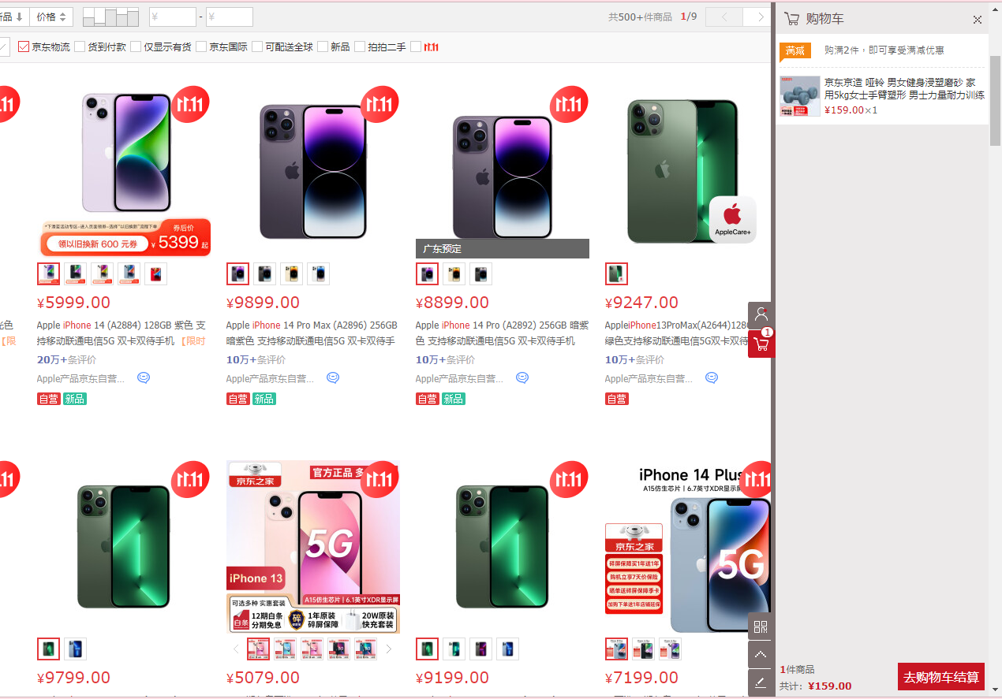
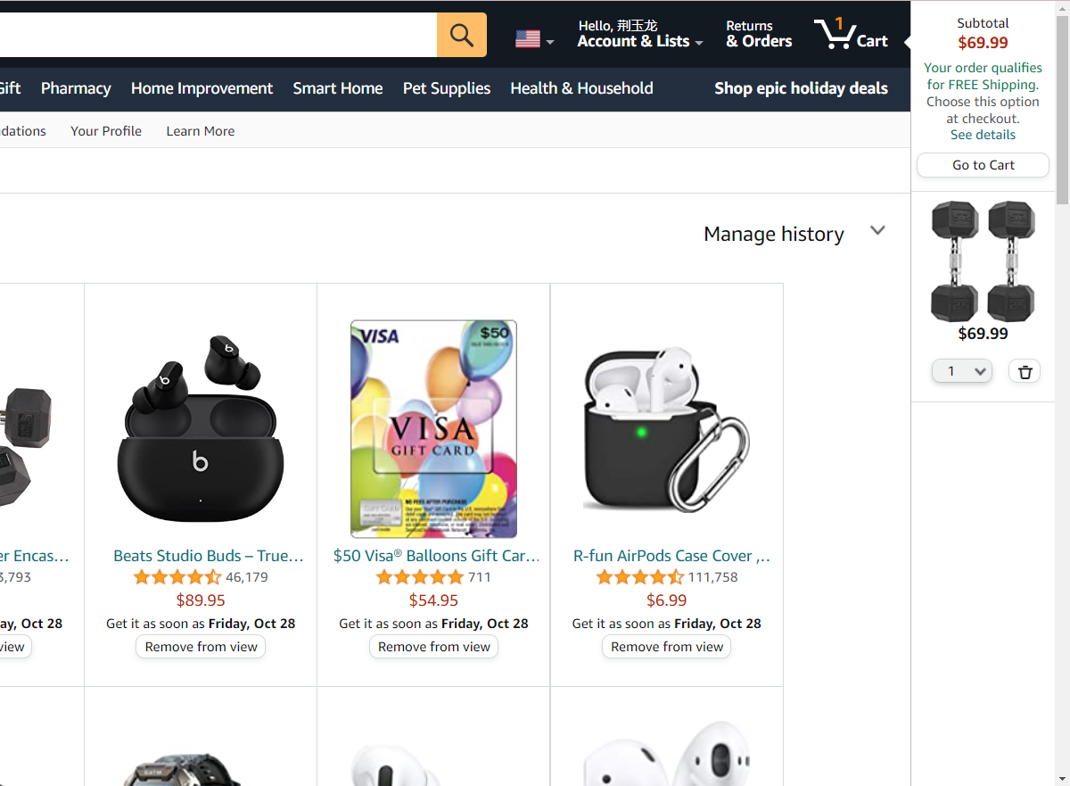
Sidebar Shopping Cart
The sidebar shopping cart of JD.com and Amazon

Slide 6
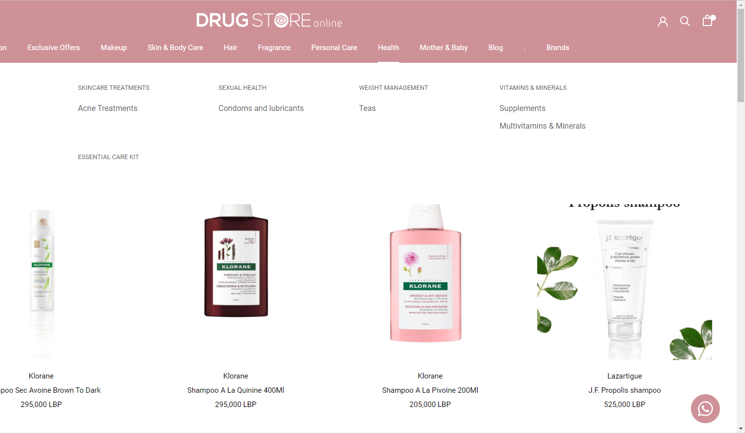
Sidebar Shopping Cart
This drug website doesn't have the sidebar shopping cart.

Slide 7


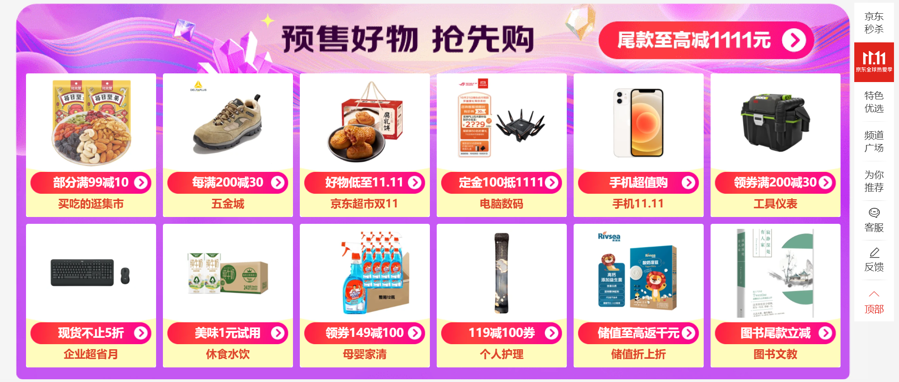
Marketing(promotional activities)

Slide 8
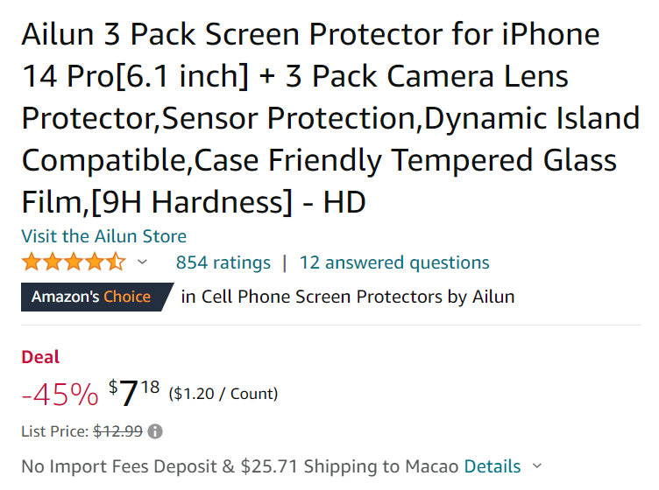

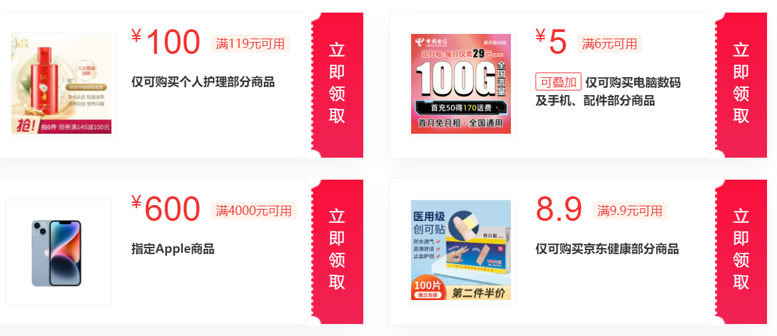
Marketing(coupons)

Slide 9
Conclusion

Slide 10

Q & A

